Slide 1

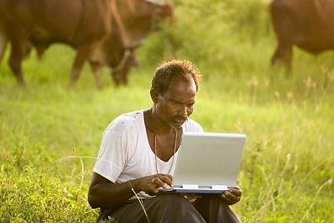
PRECISION AGRICULTURE
Technology At Farms…
By
Kaveen
Prathap
Nikhil
Hemanth
Guide
Harish V Mekali

Slide 2
Background Study
Primary source of livelihood for about 60 per cent of India’s population
The Gross Domestic Product (GDP) from the Indian agriculture sector reached 13.7 per cent in 2013
179.9 million hectares
Different climates and 46 soil types
Total agricultural exports from India expanded at a CAGR of 25.2 percent to US$ 39 billion
Courtesy- http://www.ibef.org

Slide 3
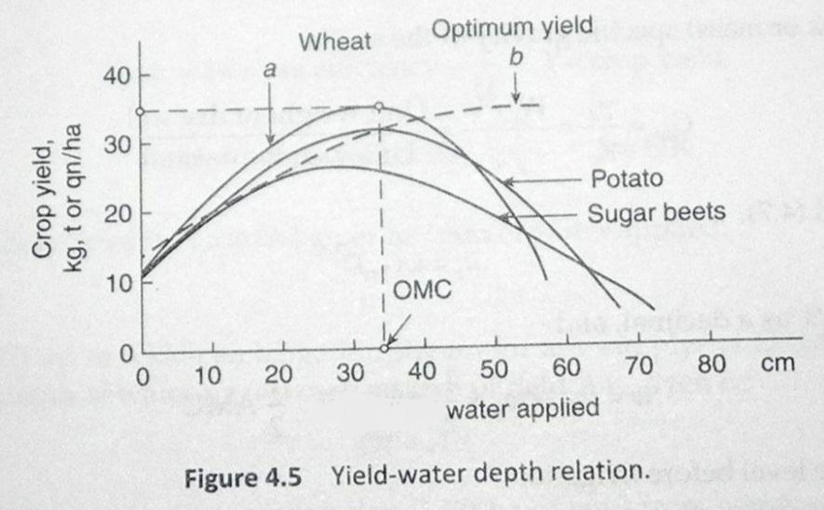
Why?
Optimum Water, Best Yield…
Fig – YIELD vs. WATER RELATION
Courtesy- Irrigation Technology by DR. Ragunath

Slide 4
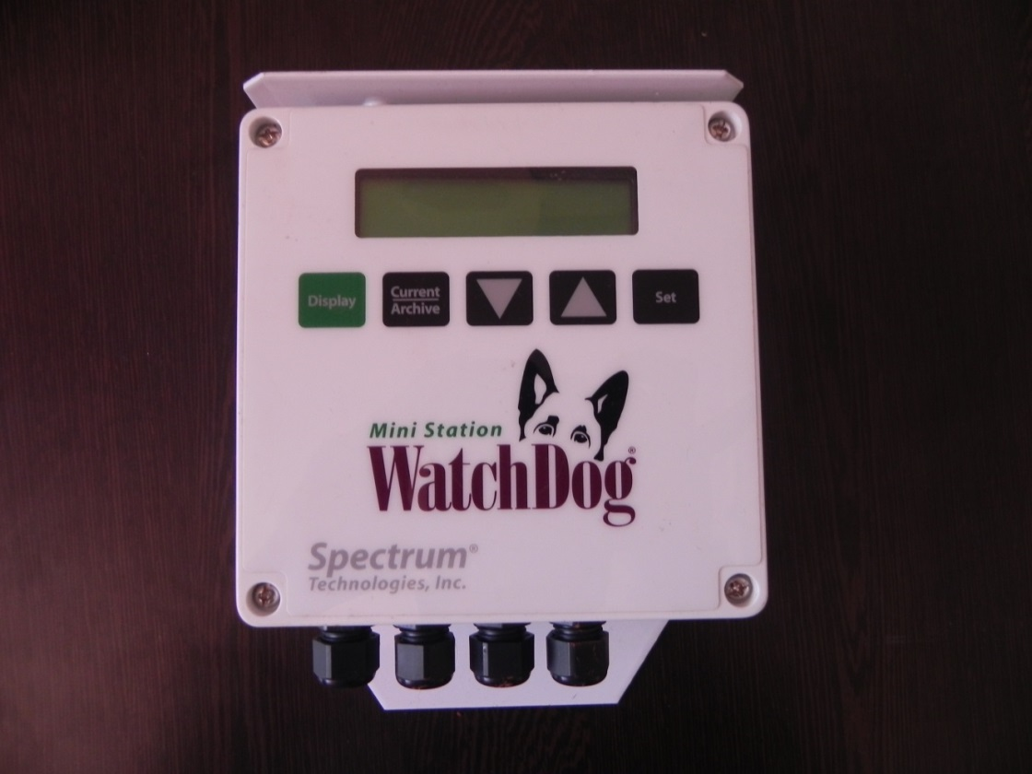
Initialization…
WatchDog
SPECS >
Sensors
4 Soil moisture sensors (SM100)
Data logger
LCD Display
Data transfer
USB to Serial
CONS >
Highly Expensive
No Customization

Slide 5
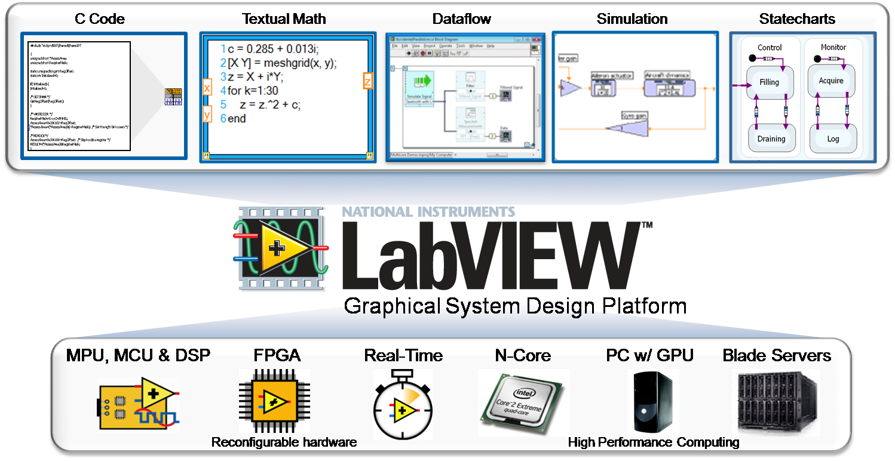
LabVIEW Management
Configuration >
Dedicated Server
Wired Connectivity
Very Expensive

Slide 6
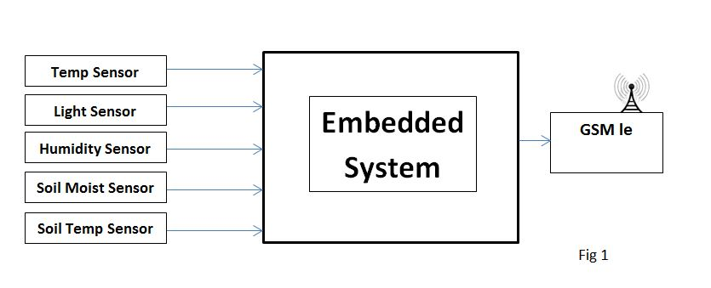
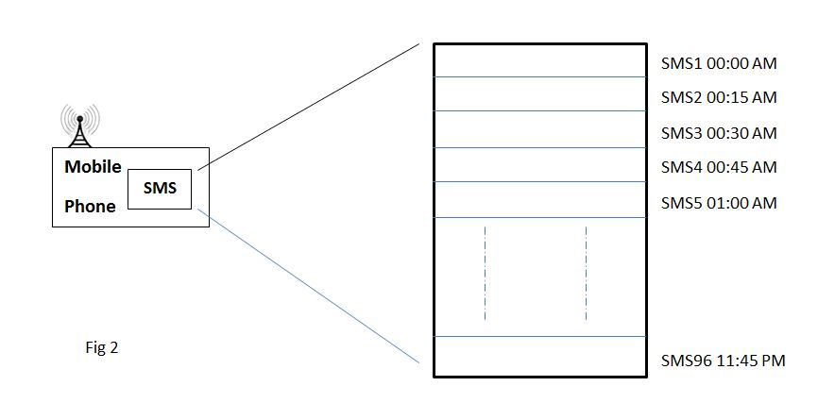
Improvisation…
Weather Monitoring
system
Sensor values read
Read values sent
Base end
Received values at the user’s hands
Temp:29⁰C SM:25% ST:18⁰C Lum:100lux RH:20%
SMS Format
User end

Slide 7
Problem Definition
Reducing the overall cost of the system
Customization feature
WSN for large area of coverage
Remote Connectivity
Management & Monitoring

Slide 8
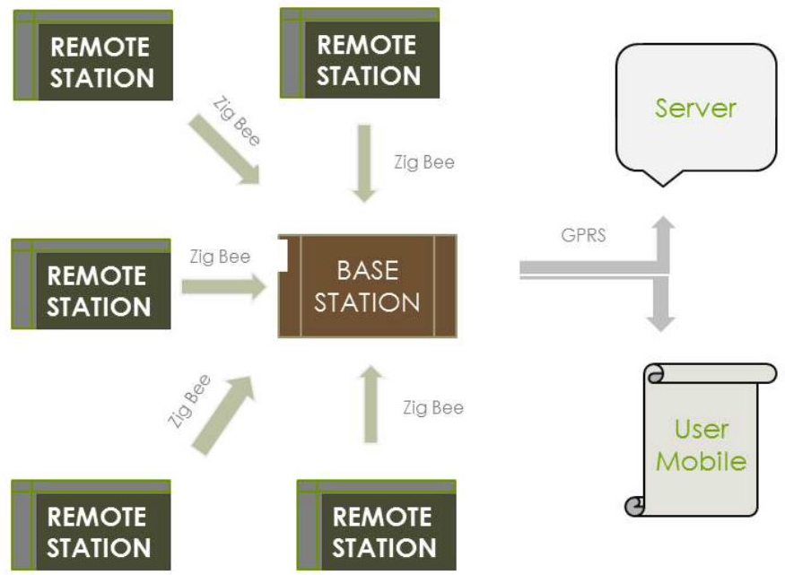
Proposed Solution…

Slide 9
Base Station…
INTERNET
SIM900
GSM MODULE
16x2 LCD DISPLAY
INPUT SENSOR PORTS
ARM CORTEX M3
FLASH
TARANG F4 ZIGBEE MODULE
Opto
Coupler
RELAY
Serial
Debugger
INPUT SUPPLY
POWER MANAGEMENT

Slide 10
Remote Station…
16x2 LCD DISPLAY
INPUT SENSOR PORTS
ARM CORTEX M0
TARANG F4 ZIGBEE MODULE
Serial
Debugger
INPUT SUPPLY
POWER MANAGEMENT

Slide 11
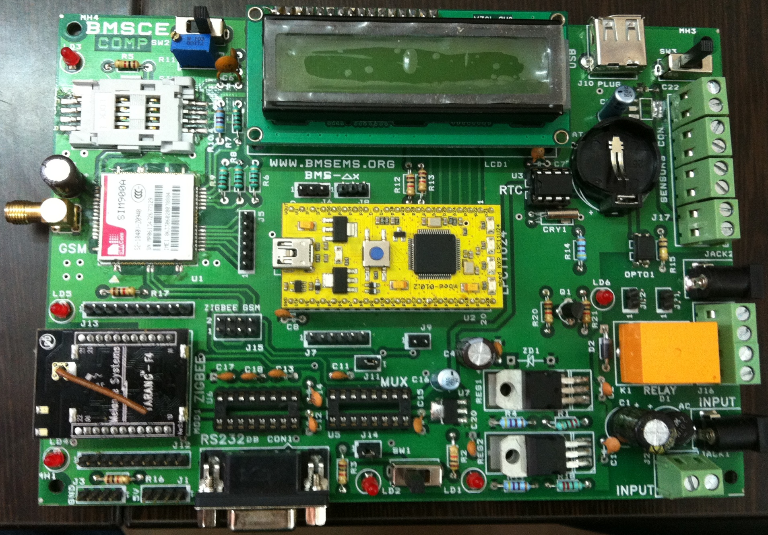
Final Model…

Slide 12
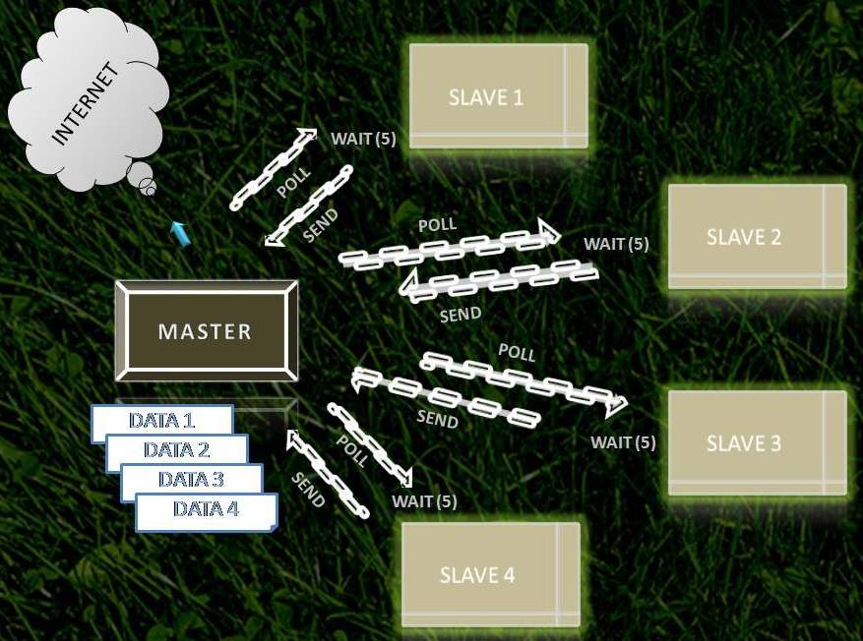
Communication...

Slide 13
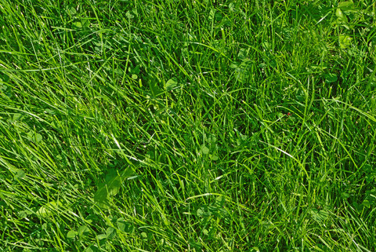
REMOTE 1
POLL
WAIT (5)
SEND
BASE
DATA 1

Slide 14
POLL
REMOTE 2
WAIT (5)
MASTER
BASE
SEND
DATA 1
DATA 2

Slide 15
MASTER
BASE
POLL
REMOTE 3
WAIT (5)
DATA 1
DATA 2
SEND
DATA 3

Slide 16
MASTER
BASE
POLL
DATA 1
DATA 2
DATA 3
WAIT (5)
DATA 4
SEND
REMOTE 4

Slide 17
INTERNET
REMOTE 1
REMOTE 2
BASE
MASTER
DATA 1
REMOTE 3
DATA 2
DATA 3
DATA 4
REMOTE 4

Slide 18
INTERNET
REMOTE 1
REMOTE 2
BASE
REMOTE 3
DATA 2
DATA 3
DATA 4
REMOTE 4

Slide 19
INTERNET
REMOTE 1
REMOTE 2
BASE
MASTER
REMOTE 3
DATA 3
DATA 4
REMOTE 4

Slide 20
INTERNET
REMOTE 1
REMOTE 2
MASTER
BASE
REMOTE 3
DATA 4
REMOTE 4

Slide 21
INTERNET
REMOTE 1
REMOTE 2
MASTER
BASE
REMOTE 3
REMOTE 4

Slide 22
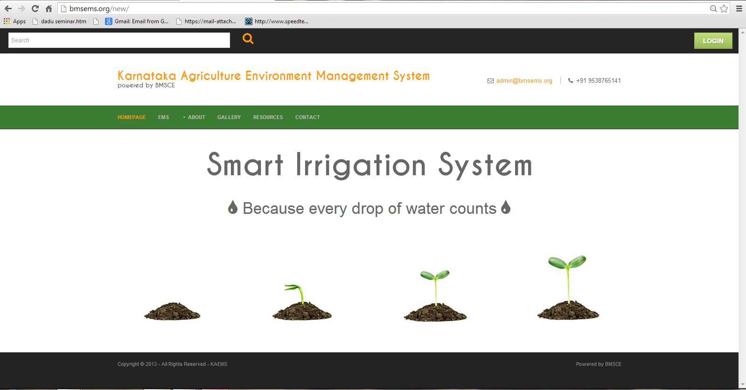
Remote Data Acquisition…
http://kaems.org/

Slide 23
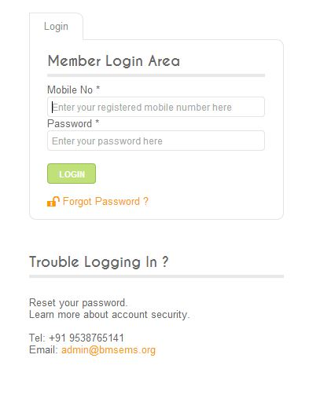
Welcome Page…
Each user is provided with his own distinct ID & a secret password through which he can access the required data.
This way both authentication of the identity and confidentiality of the data is maintained

Slide 24
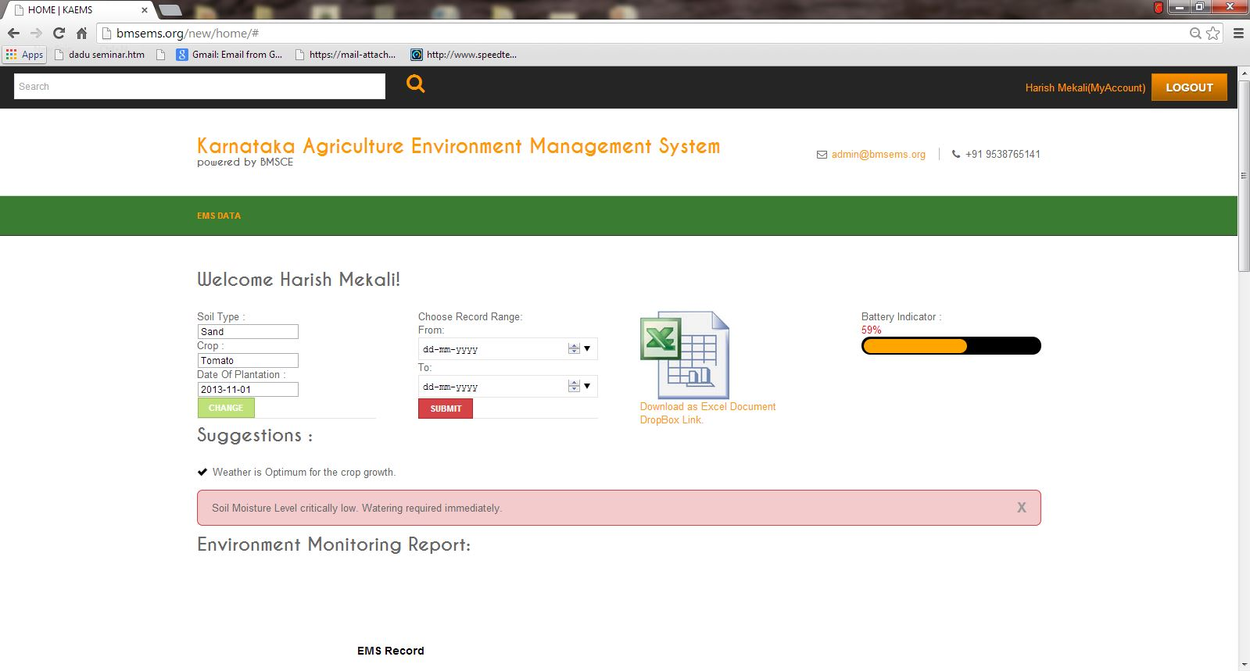
User Page…
The user has to login to the website as a member to access the data or use the website to read the parameter he wishes to get a hold on. For this he has to obtain the permission from the administrator.

Slide 25
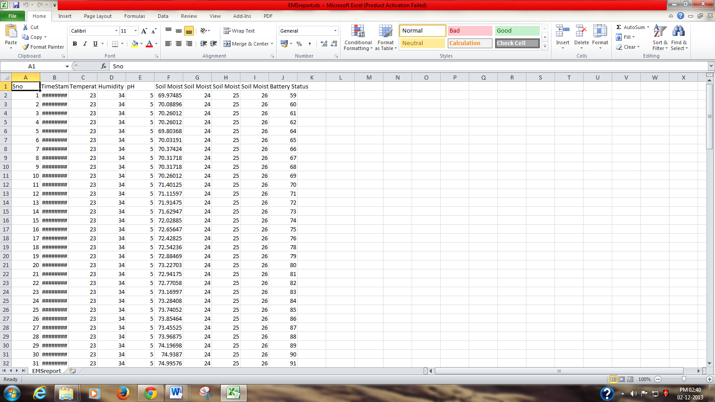
Excel Spreadsheet…
The various sensor data are collectively stored in an excel sheet which can be used later to analyse.

Slide 26
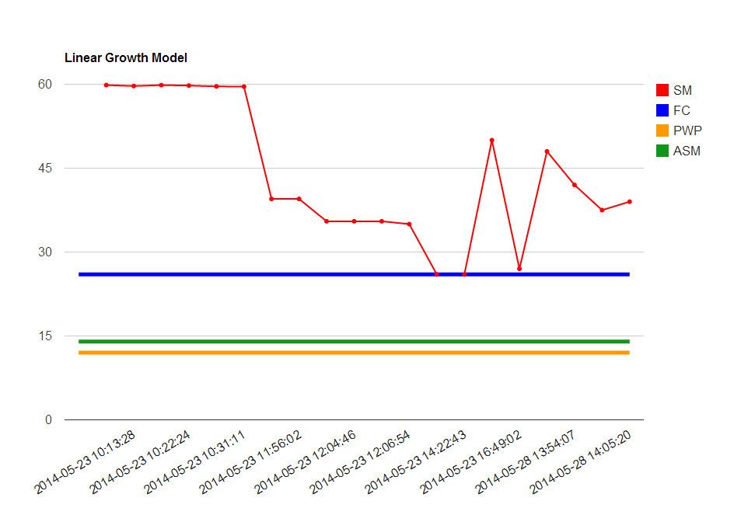
Graph
A graph displays the various sensor values employed, in detail and the output crop details.

Slide 27
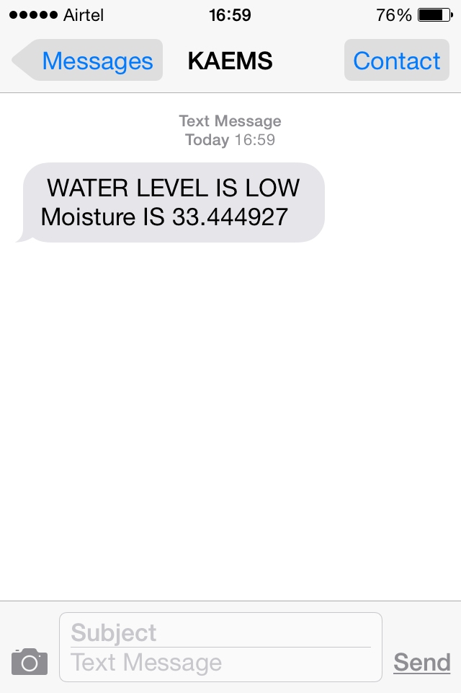
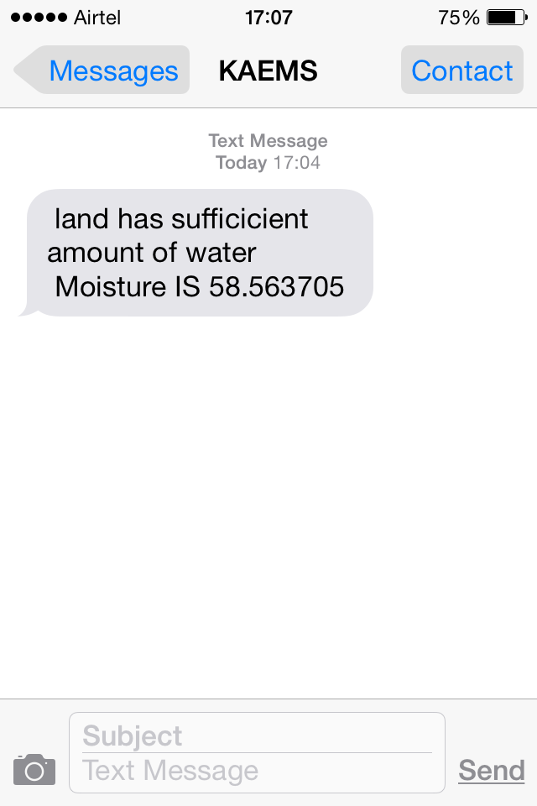
SMS Facility…
Critical Parameters are automatically updated via SMS.

Slide 28
Code Flow...
Master
Initialization of variables and network parameters
To remote station
Send the commands to slaves. wait()
Receive the remote sensor data Values from slave
From remote station
Display the sensor values
Analyze the data and Store in the Flash Storage
Data Upload
Soil Dry?
YES
NO
Relay ON
Event
Occurrence
YES
NO
Send Message
Back

Slide 29
Code Flow...
Slave-1, 2...n
Initialization of variables
Read Sensor
Display the sensor values
From base station
Receive command from master
YES
NO
Check for identity
to base station
YES
Send the data to master
Back

Slide 30
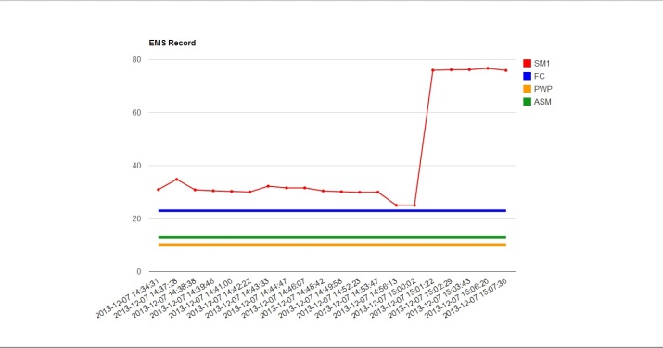


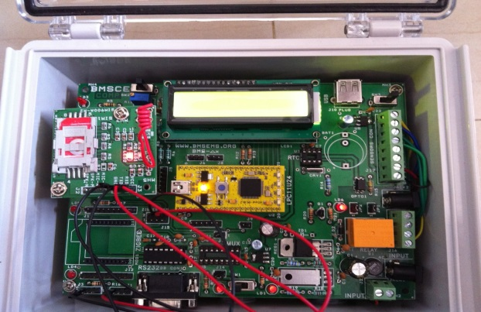

Model Overview...
Prefixed soil data base
Database from current soil data
Base station
World Wide Access

Slide 31
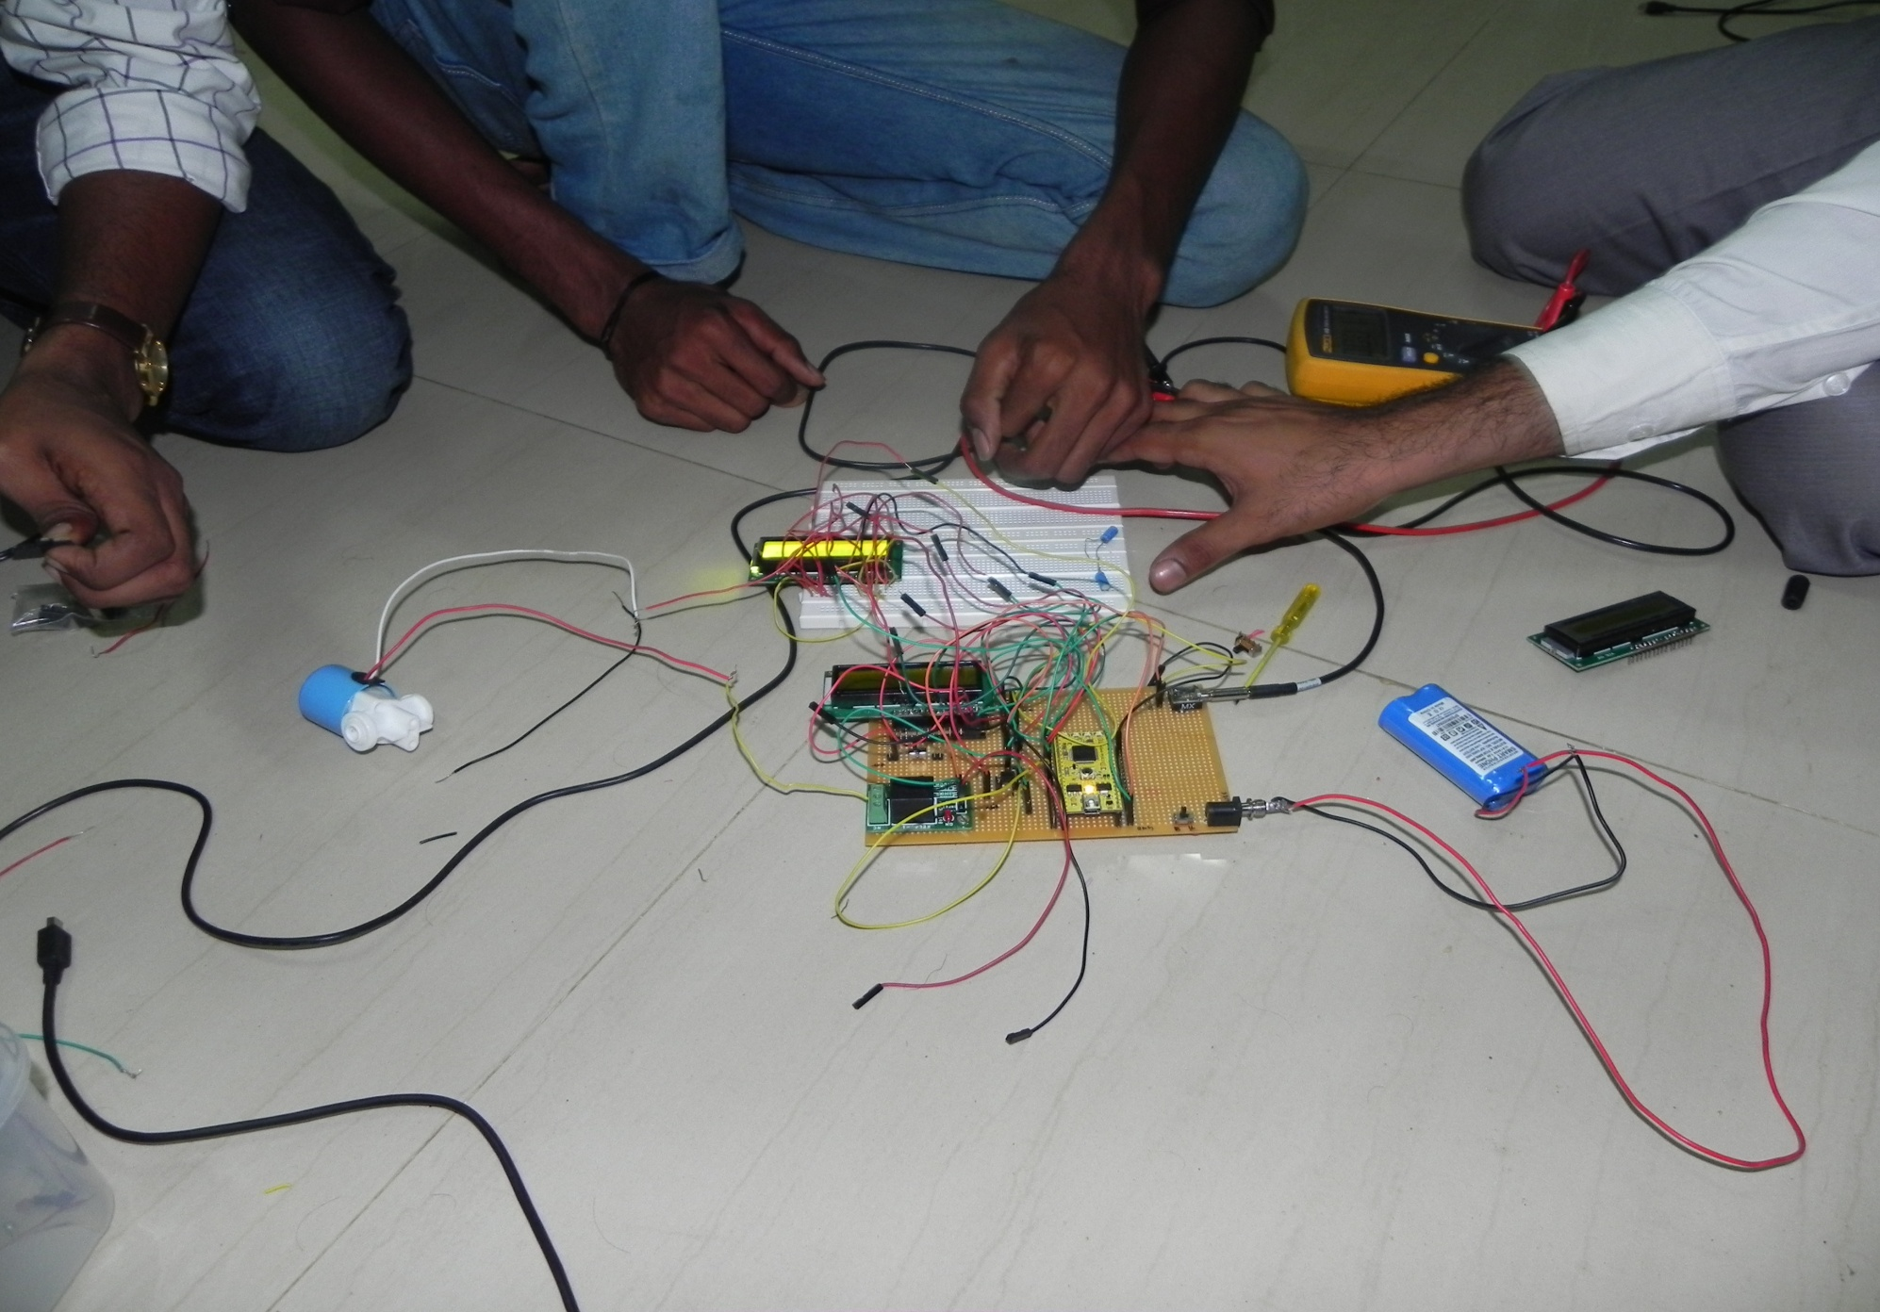
Ideation...

Slide 32
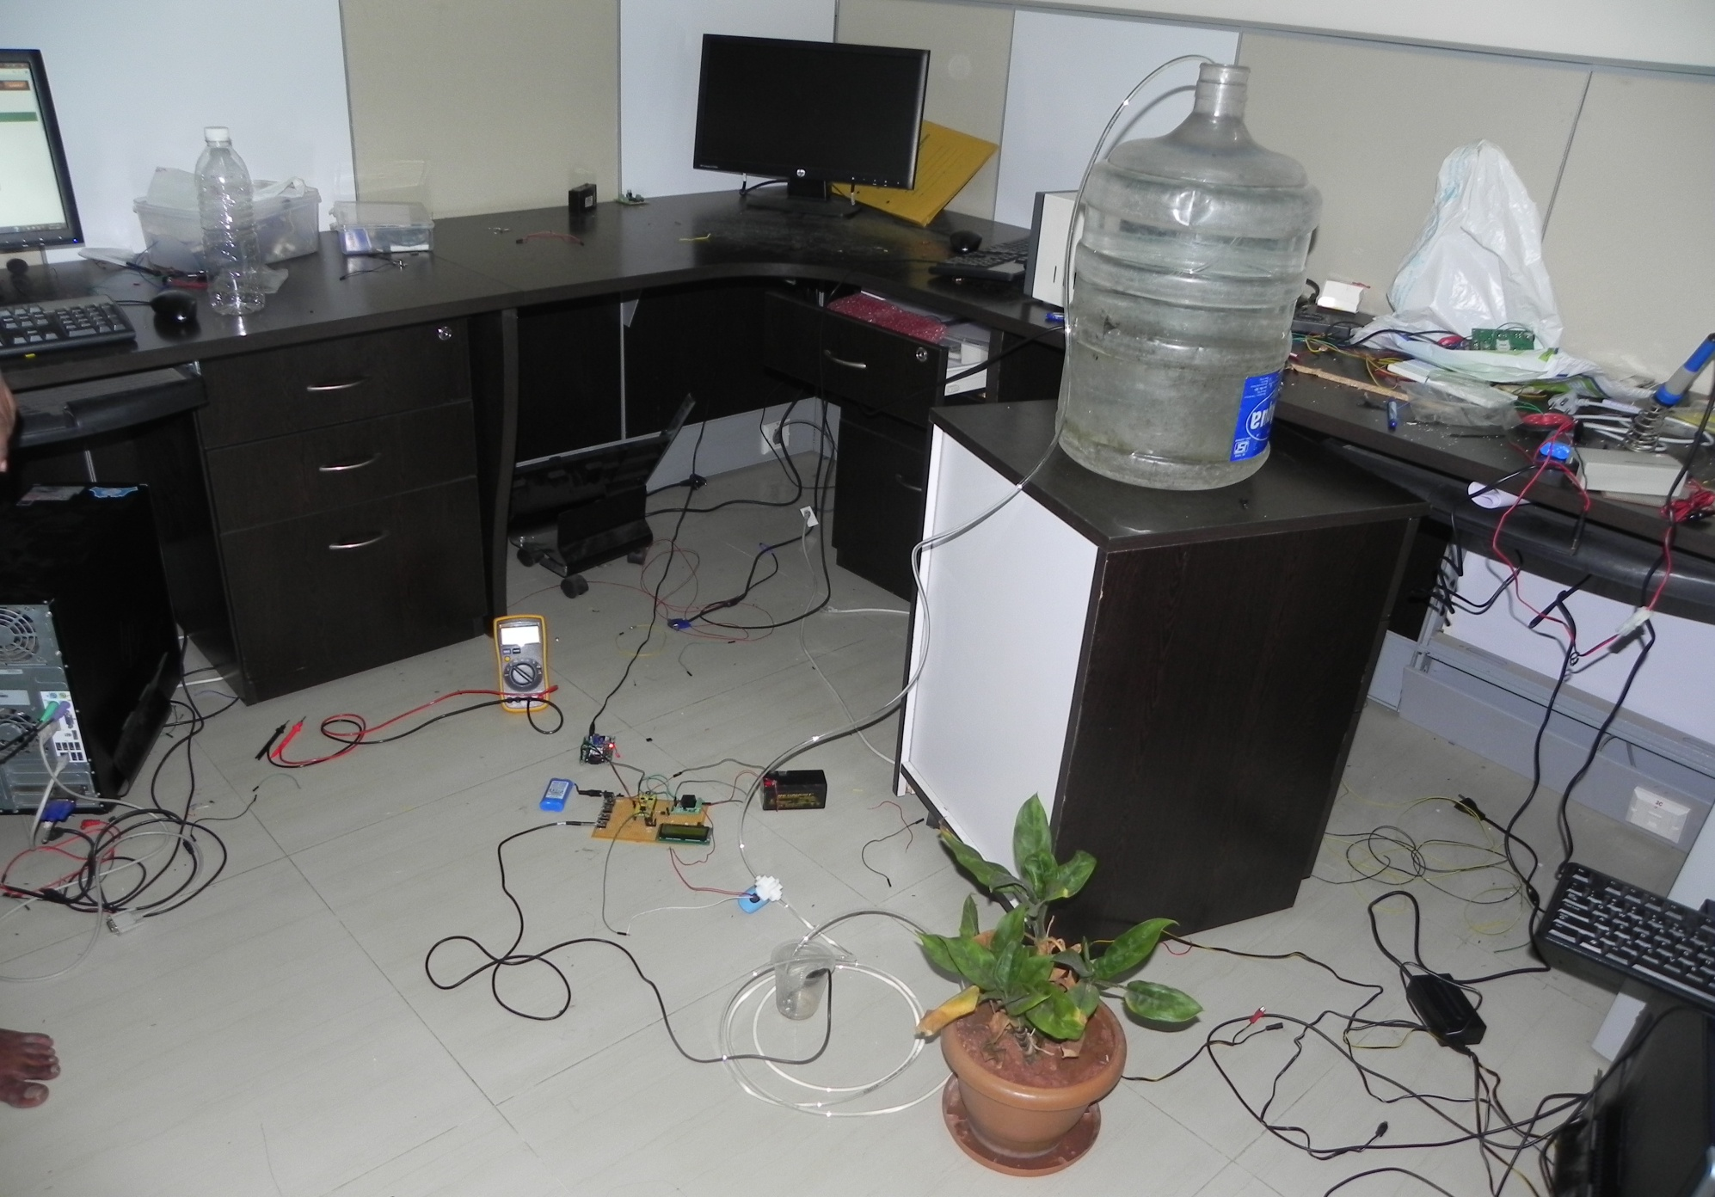
Improvisation...

Slide 33
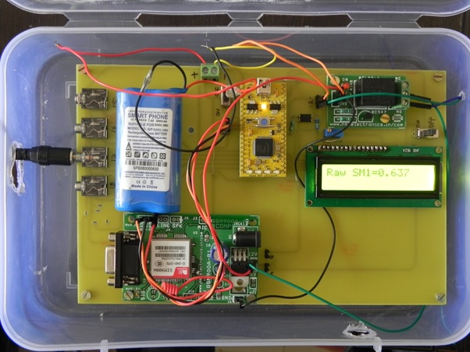
Improvisation...

Slide 34
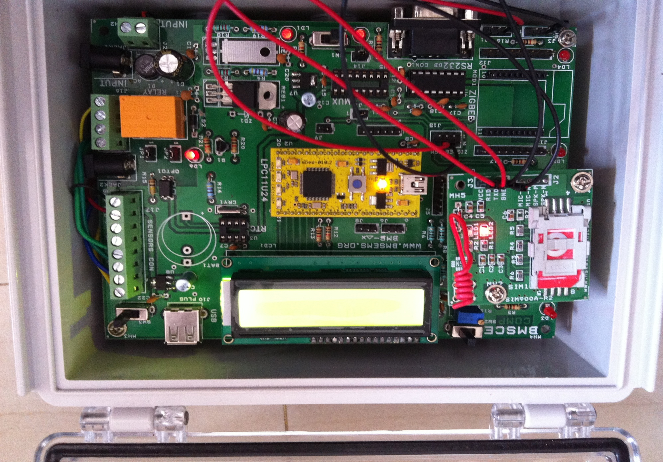
Finalization...

Slide 35
Conclusion
We proudly propose this idea to enhance the well-being of the farmers who reside at remote places to obtain the knowledge of their fields and crop information.
We feel glad to conclude that we have touched an effort of few technological fields, for sensible information management, making use of modern wireless communication such as GPRS/GSM & ZigBee

Slide 36
Possible Expansions
Low power optimization
Solar Panel implementations
Management of system through Internet
Master control through SMS

Slide 37
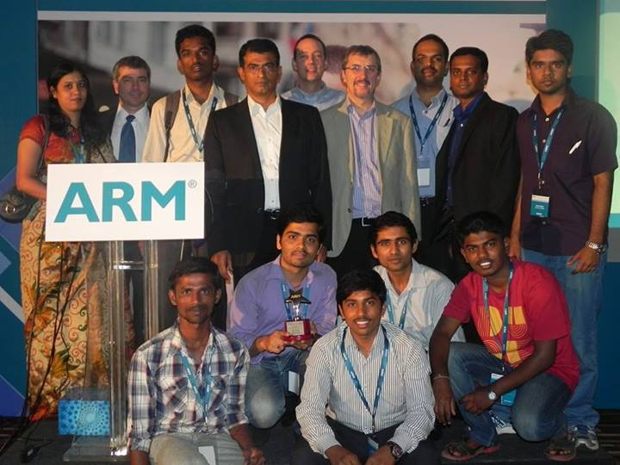
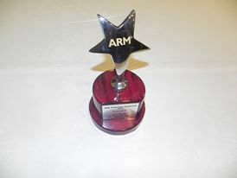
Recognition
2nd runner up in the ARM Symposium held at Le Meridian, Bangalore in the year 2013.

Slide 38
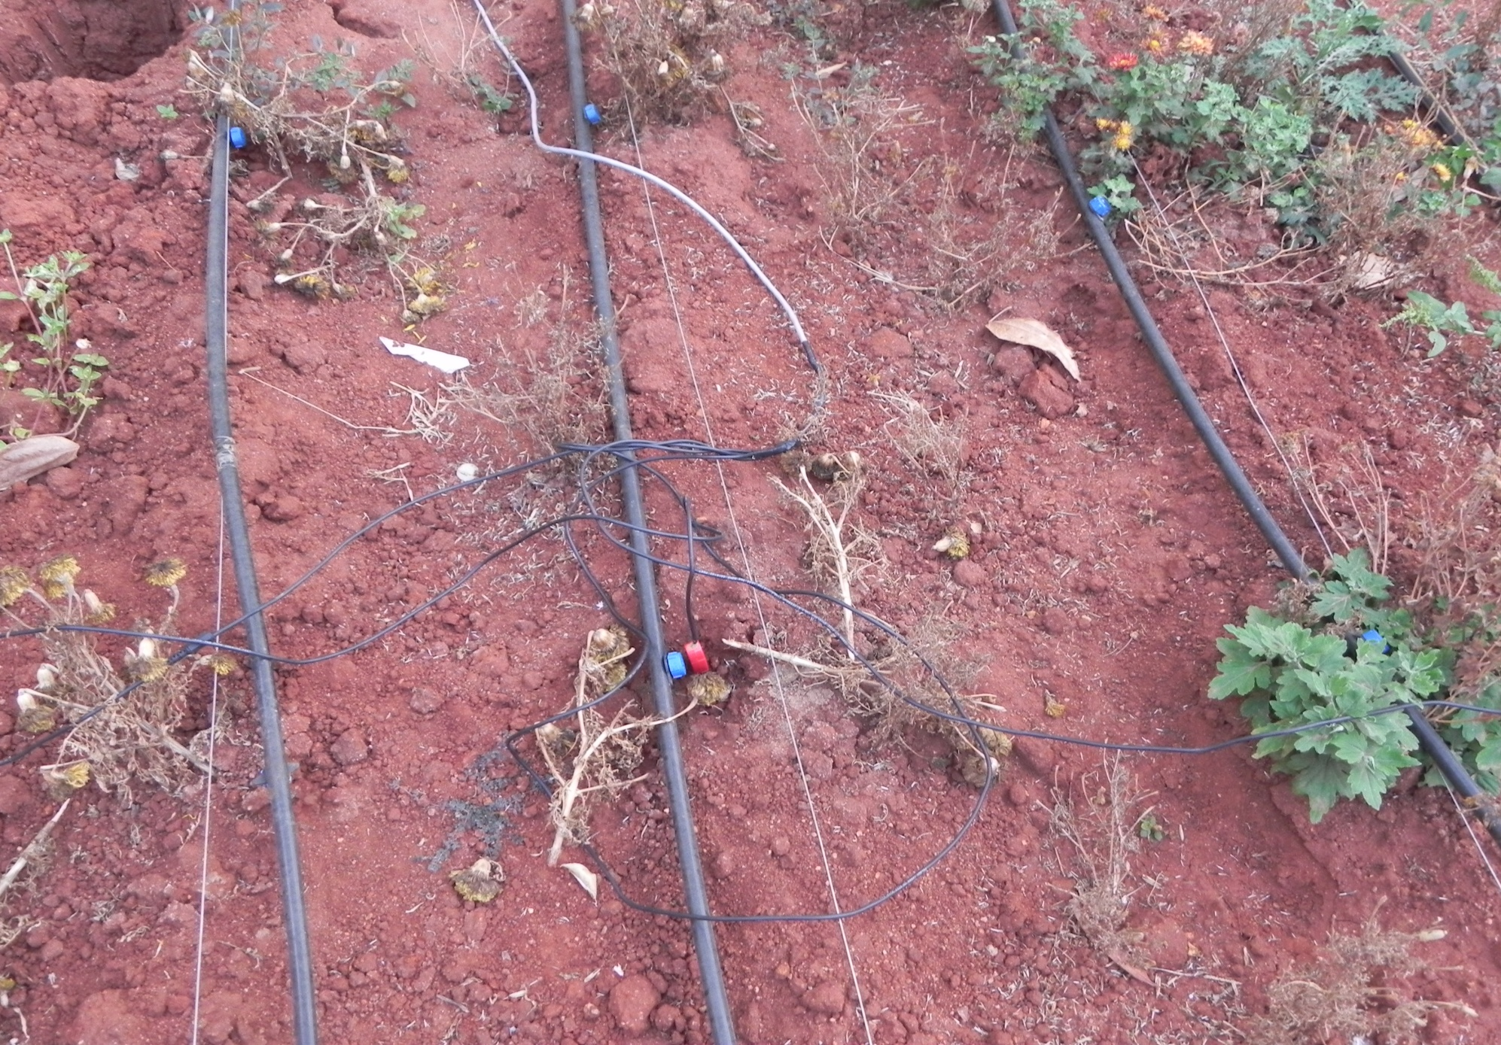
Implementation...

Slide 39
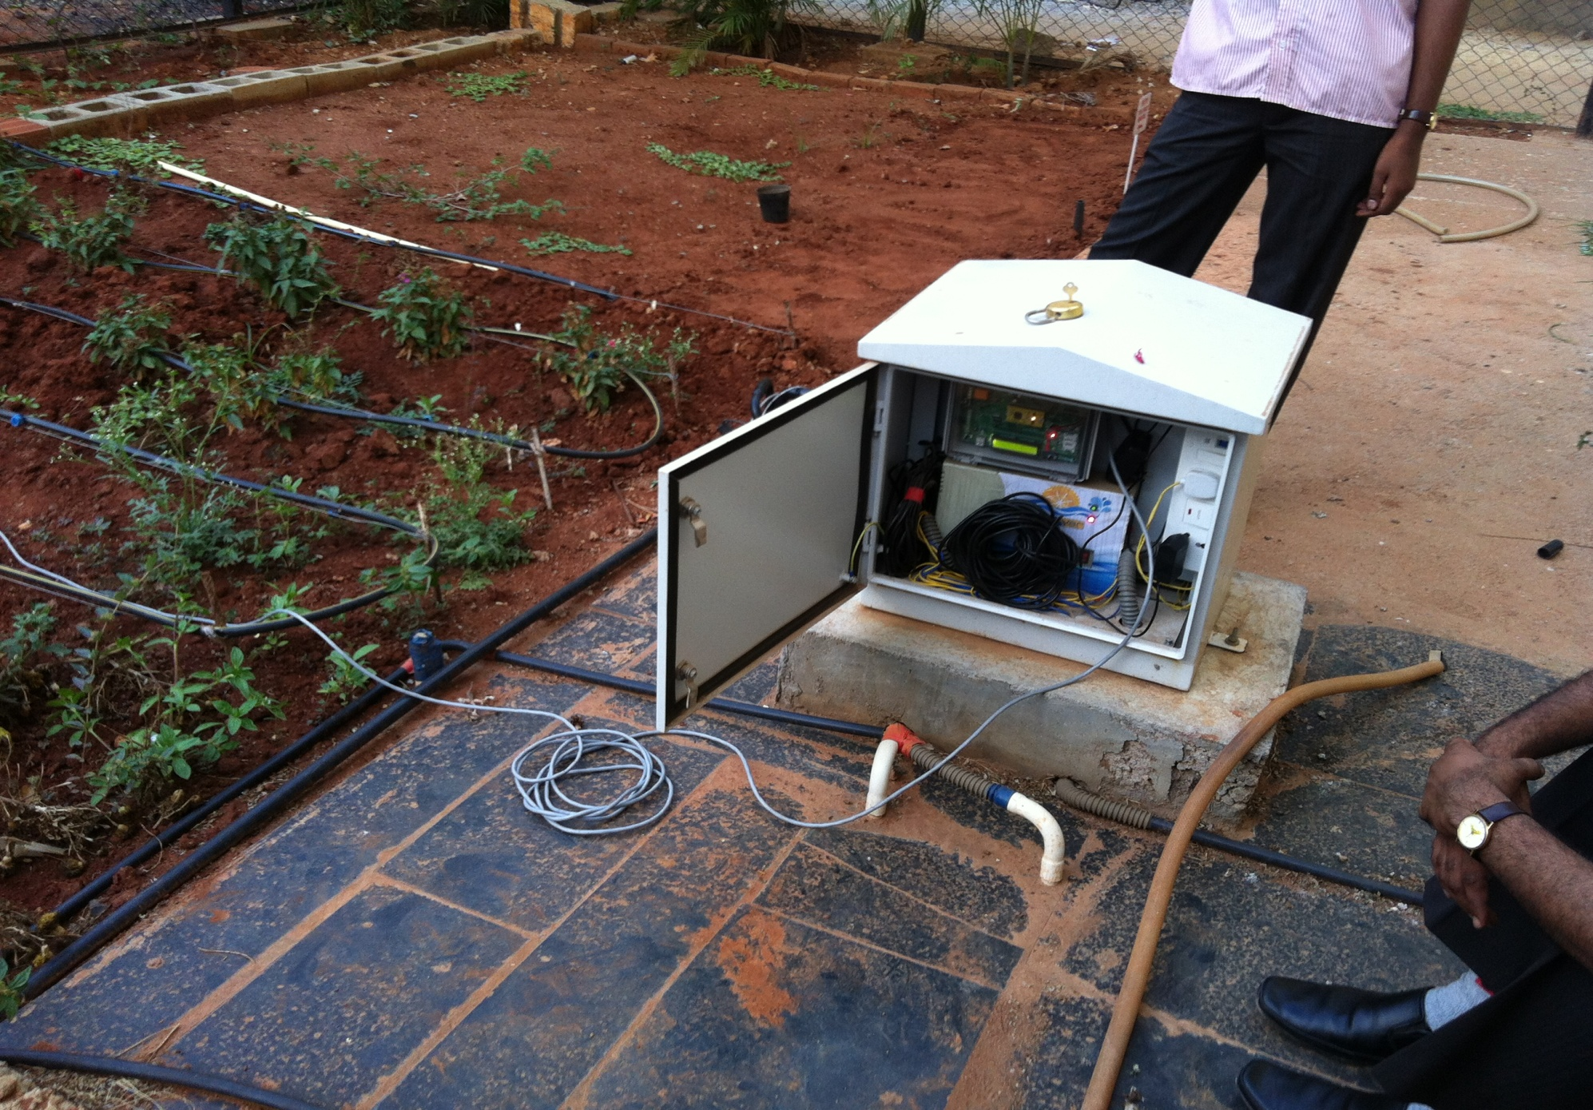
Implementation...

Slide 40
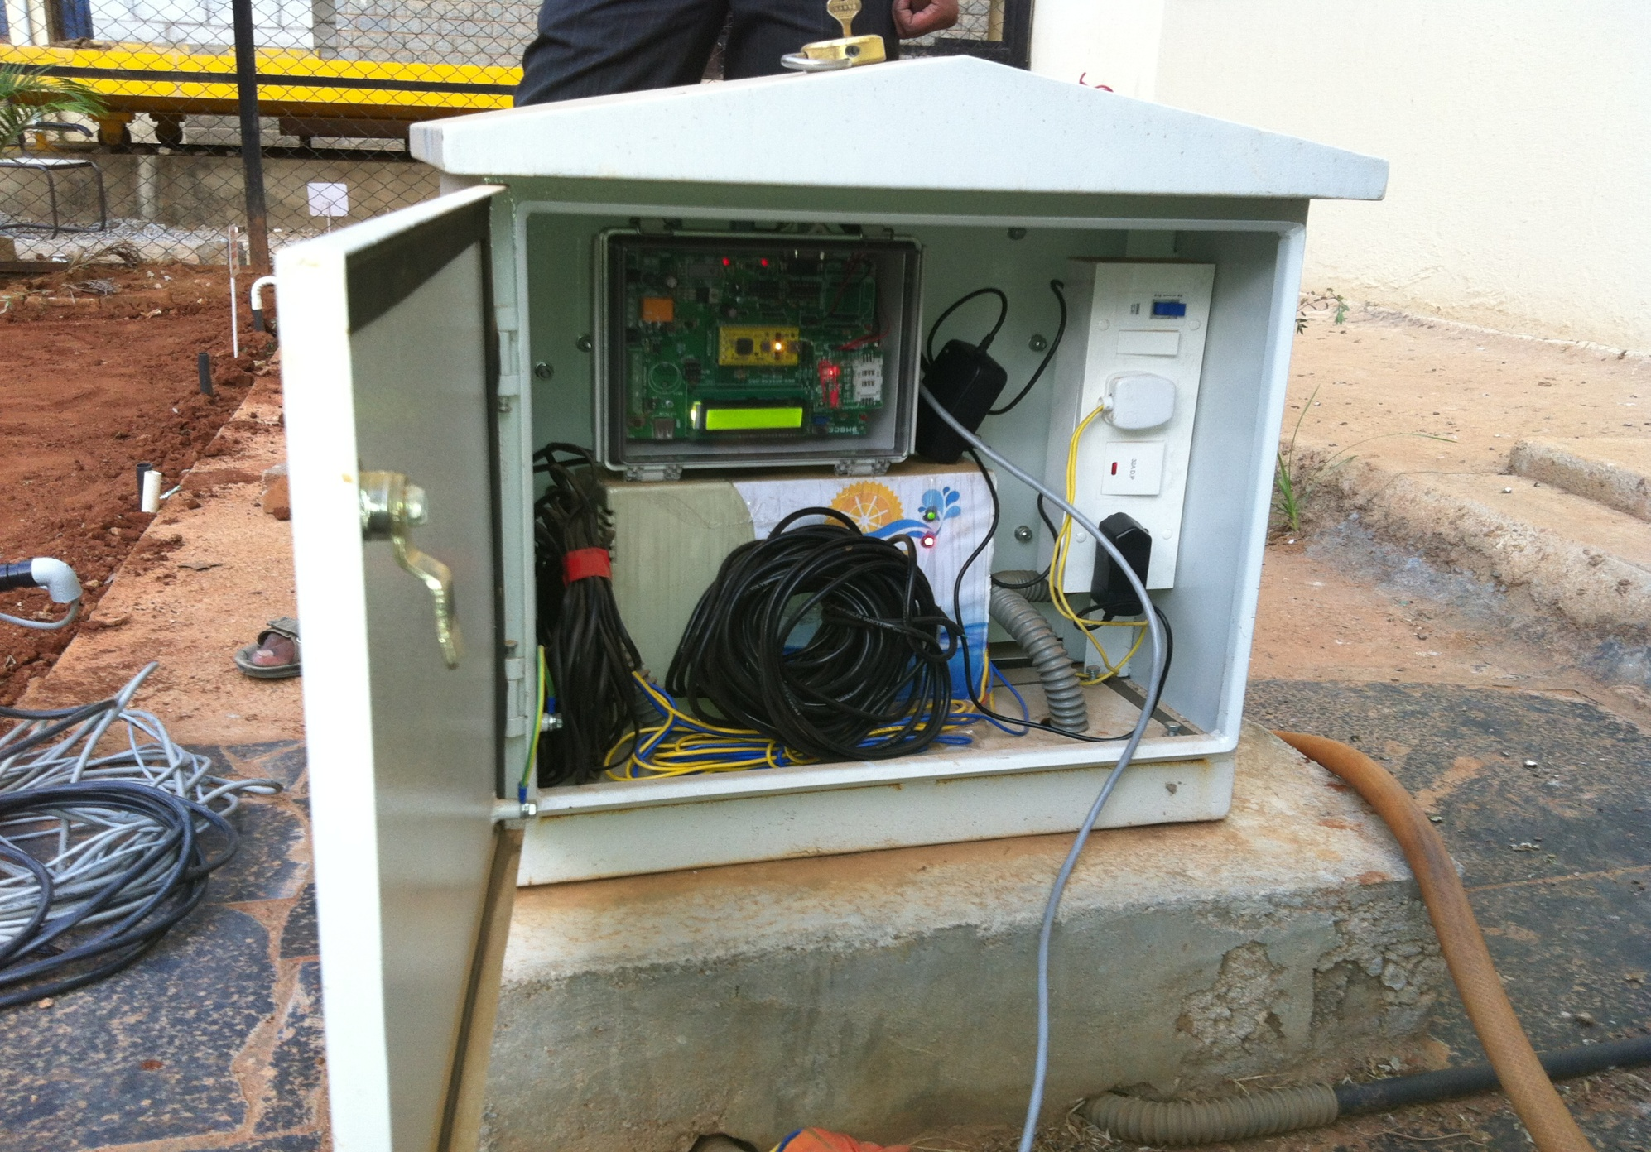
Implementation...

Slide 41
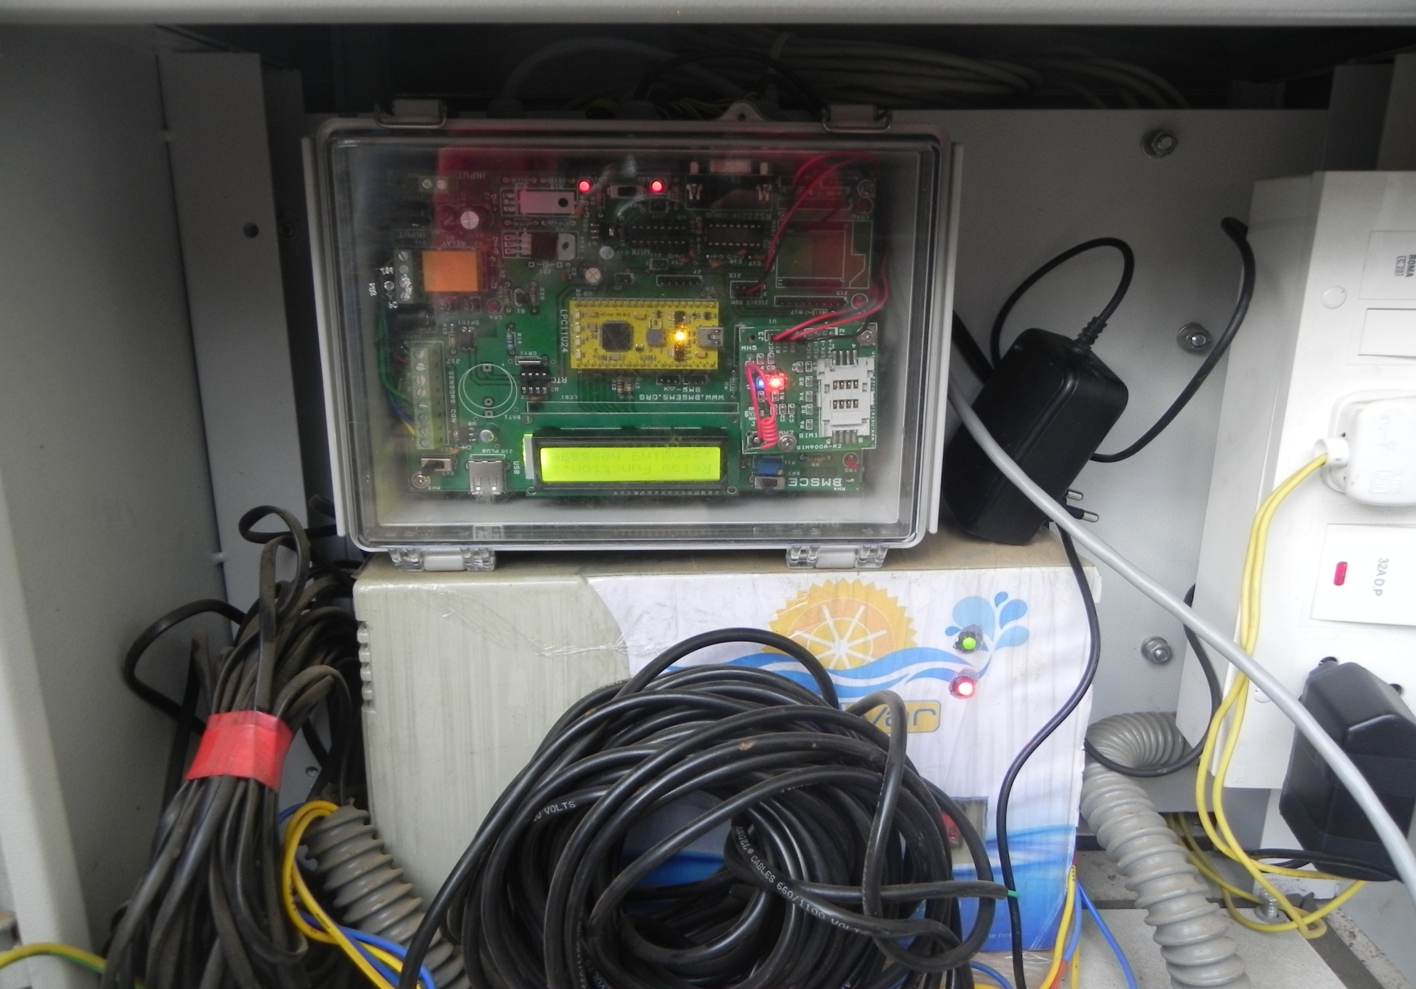
Implementation...

Slide 42
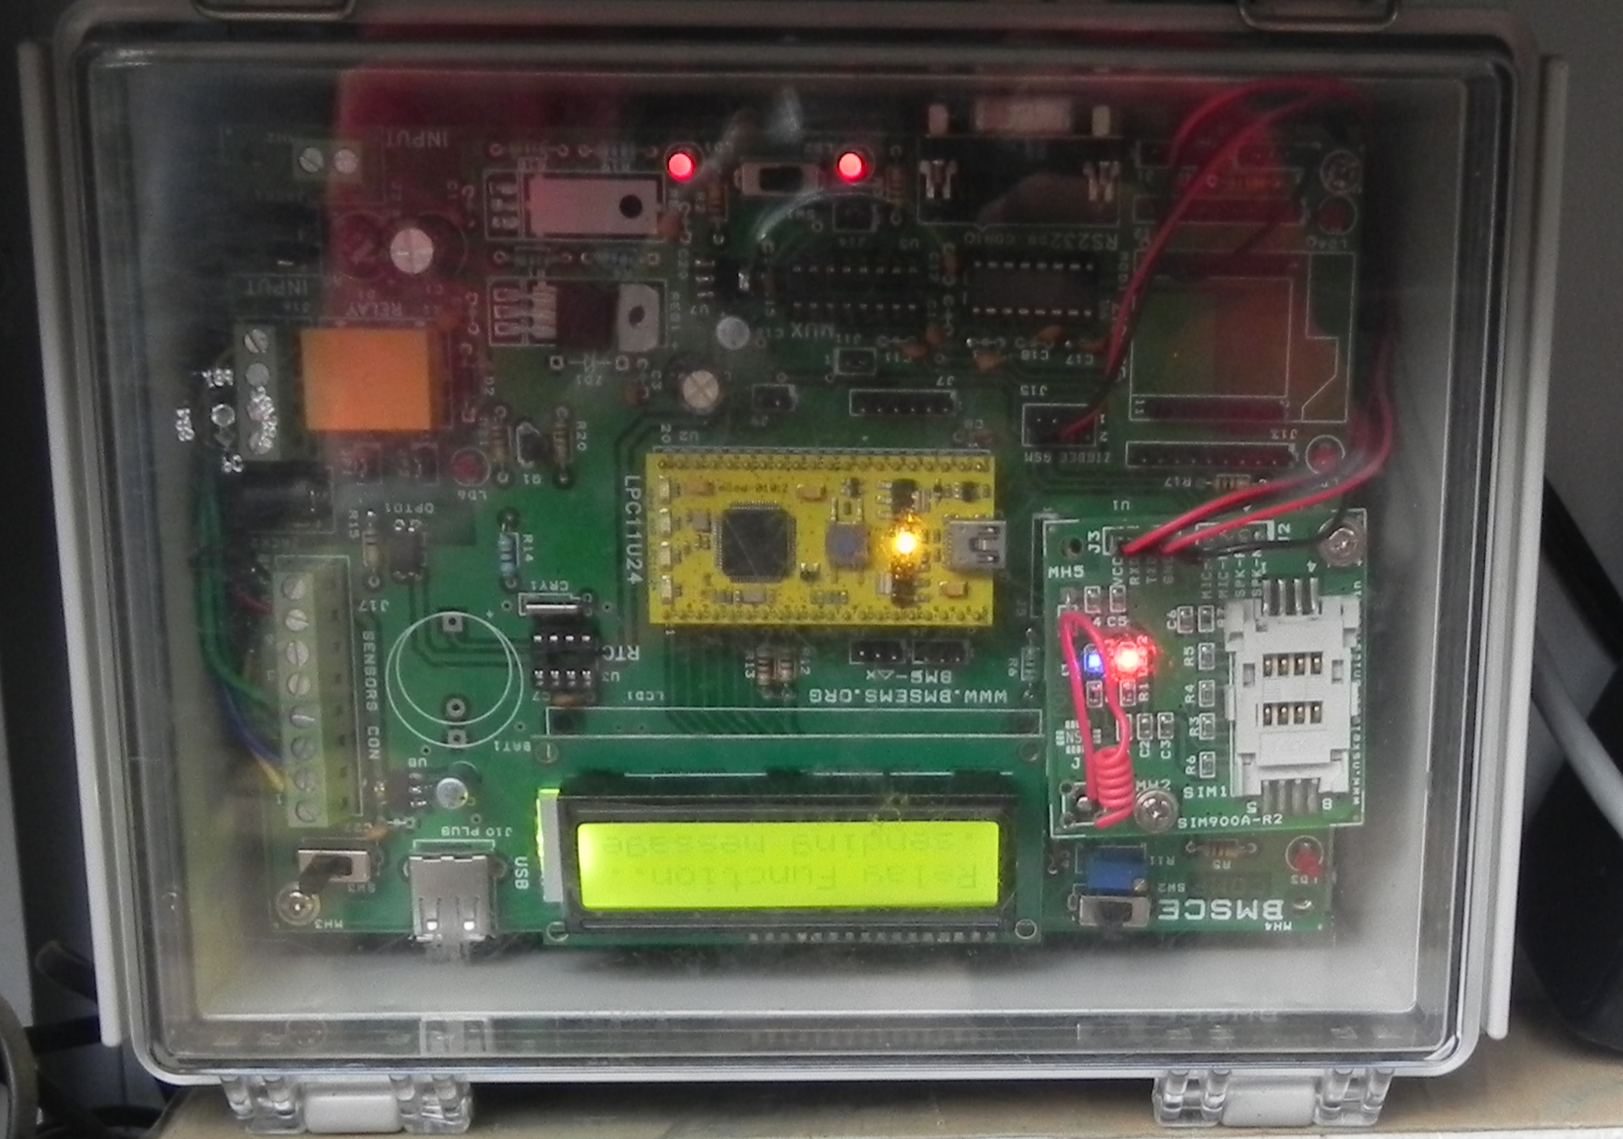
Implementation...

Slide 43
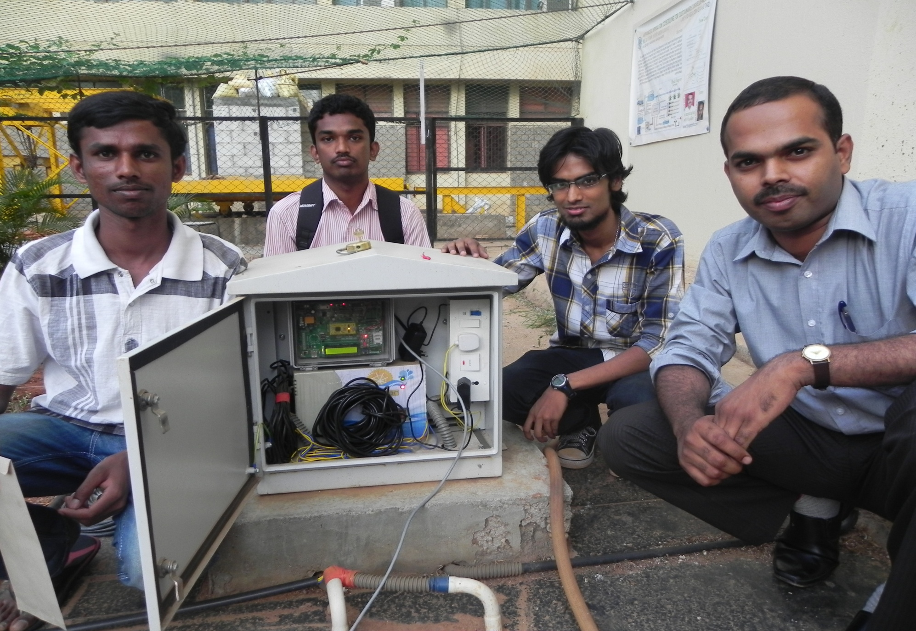
Implementation...

Slide 44
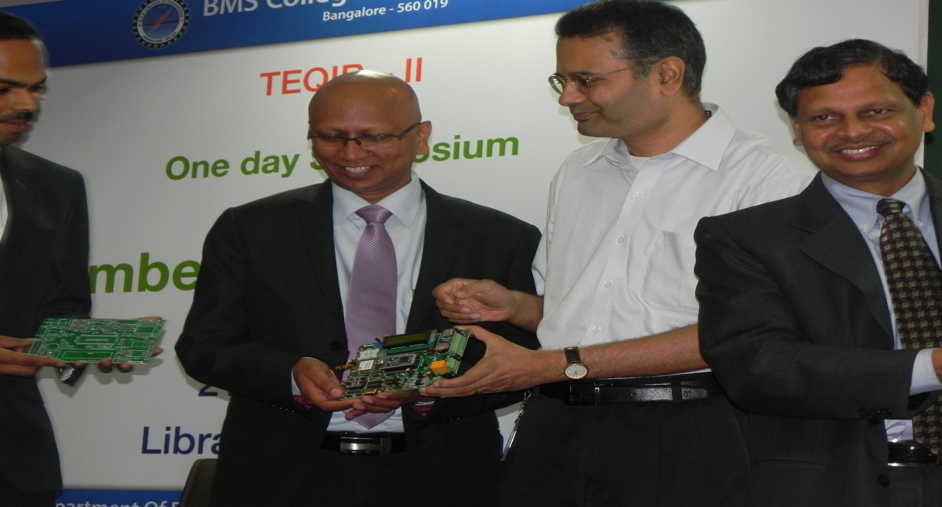
Rewards
Utmost Pride in being part of a patent filed product...

Slide 45



Sponsors…
TEQIP - II

Slide 46


Thank You
DEMO

